Slide 1


Instagram
ACCOUNT ANALYTICS
By Jitesh Jain

Slide 2
03
INTRODUCTION & OVERVIEW
LIST OF CONTENTS
04
KEY METRICS
05
QUICK INSIGHTS WITH VISUALS
06
ADDITIONAL INSIGHTS
07
RECOMMENDATIONS

Slide 3
Introduction
Overview
Diving into Instagram Analytics
Every like, comment, and share tells a story Instagram analytics helps us uncover what makes an account shine and how to keep followers engaged.
What’s Inside the Numbers?
Engagement Highlights: What’s driving likes, comments, and shares?
Audience Insights: Who’s following, and interacting, and when are they online?
Top-Performing Content: Posts, stories, or reels—what’s trending?
Growth Tips: Data-driven ways to boost reach and engagement.
The primary objective of this analysis is to help the account owner answer three important questions:
How is the content performing?
What are the audience's preferences and behaviors?
How can we optimize future posts for growth and engagement?
By addressing these questions, we aim to develop actionable strategies to improve the account’s overall performance

Slide 4
273
Post
448K
KEY METRICS
Profile Visits
303K
New Followers
17K
Comments

Slide 5
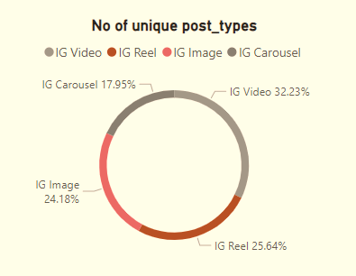
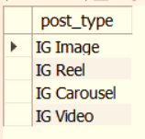
QUICK INSIGHTS WITH VISUALS
Unique post types are found in the 'fact content' table

Slide 6
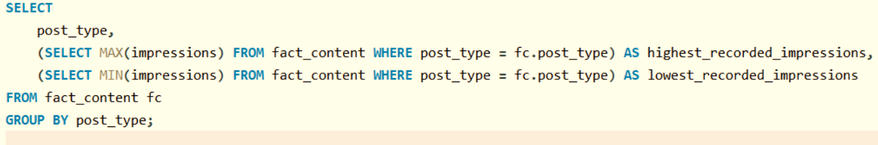
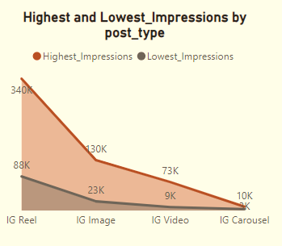
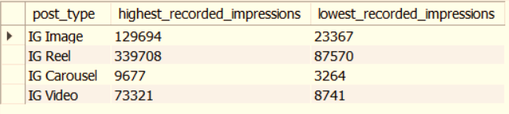
The highest and lowest recorded impressions for each post type

Slide 7
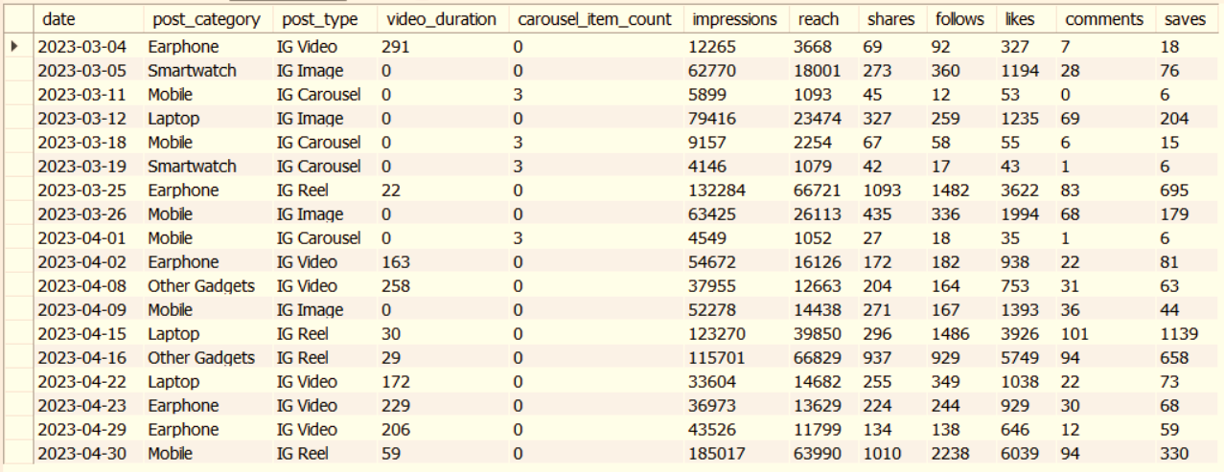
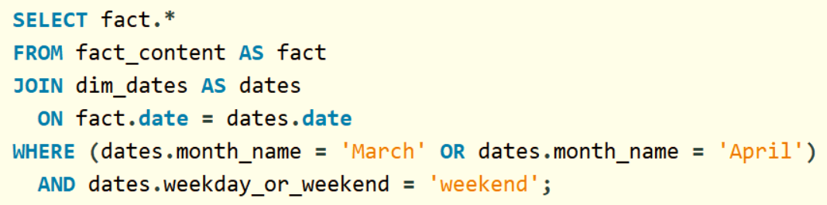
Filter all the posts published on the weekend in March and April and export them to a separate CSV file.

Slide 8
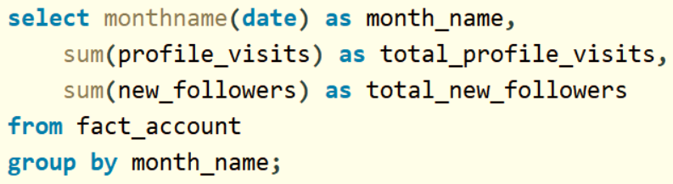
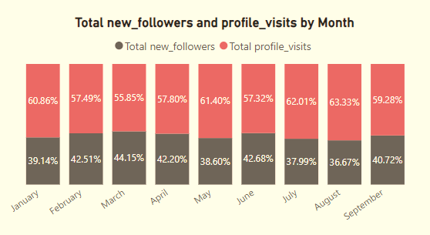
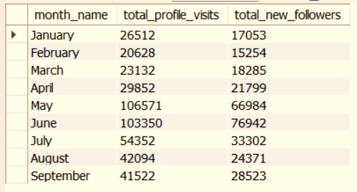
The final output includes the following fields:
• month name
• total_profile_visits
• total_new_followers

Slide 9
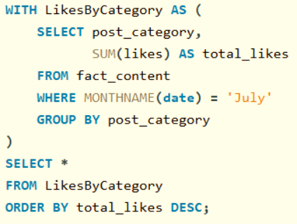
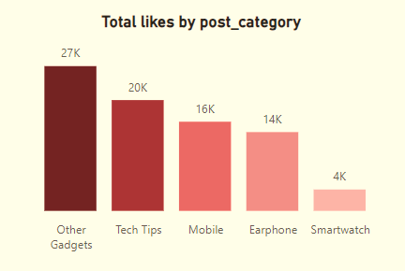
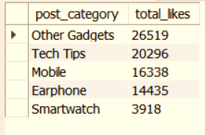
Write a CTE that calculates the total number of 'likes’ for each 'post category' during the month of 'July' and subsequently, arrange the 'post category' values in descending order according to their total likes.

Slide 10
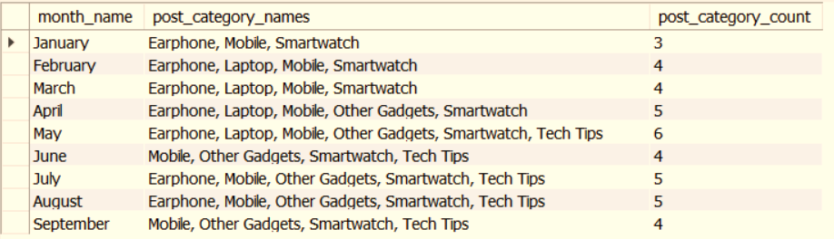
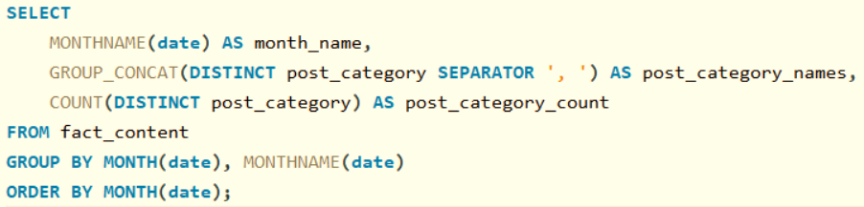
The unique post_category names alongside their respective counts for each month.
The output should have three columns:
• month name
• post_category_names
• post_category_count

Slide 11
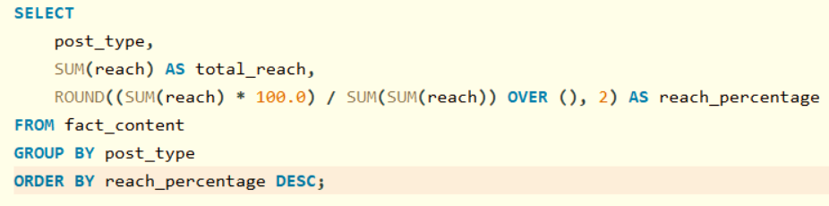
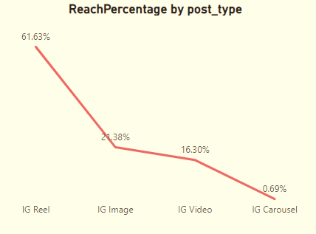
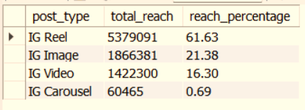
The percentage breakdown of total reach by post type
The final output includes the following fields:
• post type
• total reach
• reach percentage

Slide 12
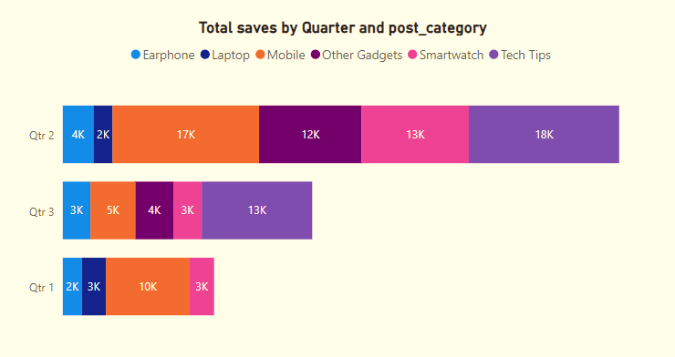
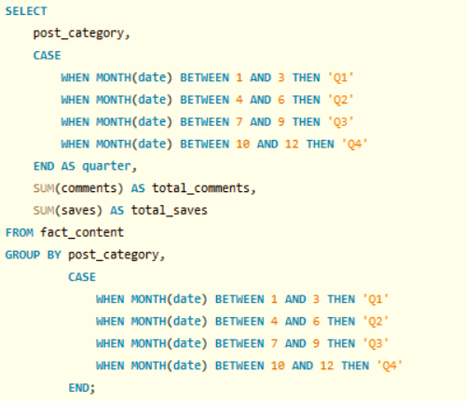
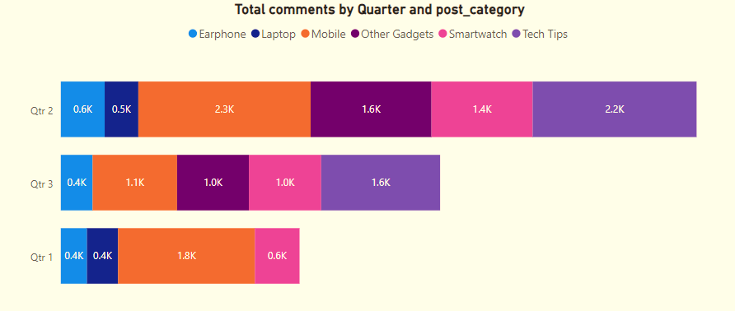
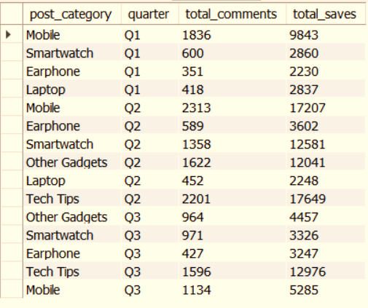
The final output columns should consist of: • post_category • quarter • total comments • total saves

Slide 13
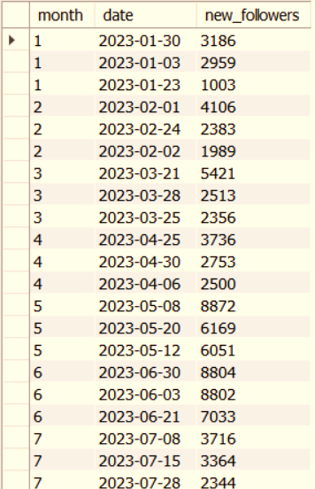
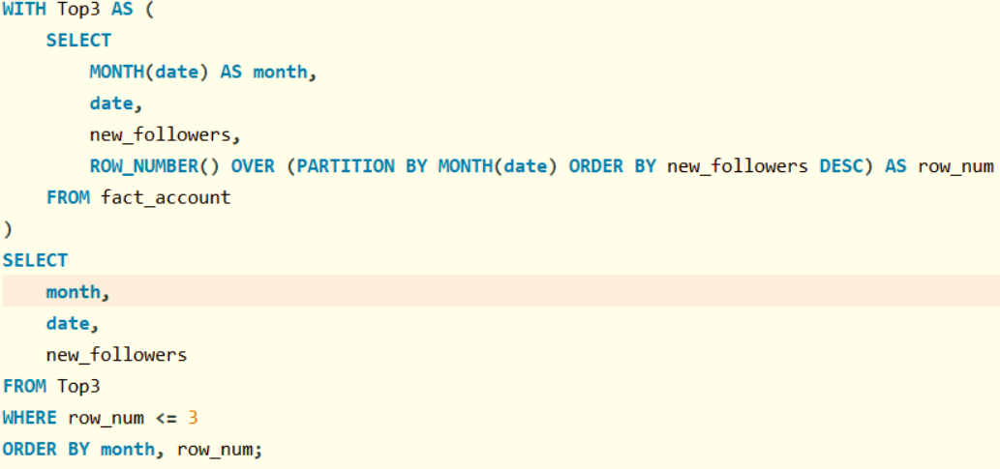
List the top three dates in each month with the highest number of new followers. The final output should include the following columns: • month • date • new followers

Slide 14
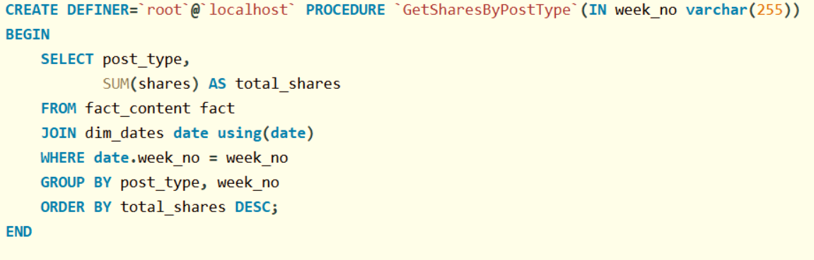
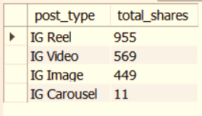
A stored procedure that takes the 'Week no' as input and generates a report displaying the total shares for each 'Post type'. The output of the procedure should consist of two columns: • post type • total shares

Slide 15

9M
167
4.79%
ADDITIONAL INSIGHTS
Total Reach
Total Carousel
Content Performance
Here are some of the major findings and recommendations from the analysis:
Top-Performing Content: Carousel posts with concise captions generated the highest engagement. I recommend increasing the frequency of carousel posts.
Audience Behavior: The audience is most active between 6 PM and 9 PM, which aligns with peak engagement times. Scheduling posts during this window can maximize visibility.
Hashtag Effectiveness: Posts with targeted hashtags had significantly higher reach. A mix of trending and niche hashtags is recommended.
Story Engagement: Stories performed well, particularly when they included interactive elements like polls or Q&A. Leveraging more stories with engagement features can build stronger connections with the audience.
Content Gaps: While video posts performed well, they were underutilized. Increasing video content can help attract more viewers
Total Reach - Content Total Reach is the number of unique users who have seen your content, regardless of how many times they viewed it.
Total Carousel - It is the number of unique users who have interacted with a carousel post, regardless of how many times they swiped through it.
Content Performance - A measure of how well your content engages your audience, based on interactions like likes, comments, and shares.

Slide 16
Recommendations
1. Track Engagement Metrics Regularly:
Likes, Comments, Shares, Saves: Monitor these to understand how users are interacting with your posts. Higher engagement means your content resonates well with your audience.
Engagement Rate: Keep track of this by dividing total interactions by impressions or reach. It gives you a better sense of content performance relative to audience size.
2. Measure Content Reach and Impressions:
Reach: Track the number of unique users who see your posts to understand how far your content is spreading.
Impressions: Monitor this to see how many times your content has been displayed, which is useful for gauging visibility.
3. Content Diversity:
Post a variety of content (images, videos, carousels, reels) to keep your audience engaged. Track which format performs best.

Slide 17
THANKS
FOR WATCHING
AtliQ Technologies
Virtual Internship Project

